Slide 1
Introduction to Pneumonia - Epidemiology & Pathophysiology
Dr Siddalingaiah H S
Professor, Community Medicine
MBBS Phase 3 Part 1 Integration Class - Day 1

Slide 2
Learning Objectives
By end of this session, MBBS students will be able to:
1. Define pneumonia using clinical & radiological criteria
2. Classify pneumonia types by etiology & acquisition
3. Explain global & national pneumonia burden data
4. Describe pathophysiological mechanisms of pneumonia
5. Identify host & environmental risk factors
CBME Competencies: Medical Knowledge, Patient Care, Systems-Based Practice

Slide 3
What is Pneumonia?
Acute infection of lung parenchyma characterized by:
Consolidation of alveoli
Inflammatory exudate accumulation
Impaired gas exchange
Typical vs Atypical presentations
Community vs Hospital-acquired

Slide 4
Pneumonia Classification
Category | Definition | Examples | Microbiology
Community-Acquired | <48 hours hospital admission | Healthy adults | S. pneumoniae, M. pneumoniae
Hospital-Acquired | ≥48 hours admission | ICU patients | MDR pathogens, P. aeruginosa
Ventilator-Associated | ≥48-72 hours intubation | Mechanically ventilated | ESBL producers, MRSA
Healthcare-Associated | Recent healthcare exposure | LTCF residents | Mixed bacterial flora

Slide 5
Global Pneumonia Burden
📊 Key Statistics:
Annual cases: 156 million worldwide
Annual deaths: 2.5 million people
Leading cause: Top infectious disease killer
Age distribution: 71% in children <5 years
Adult mortality: 600,000 deaths annually

Slide 6
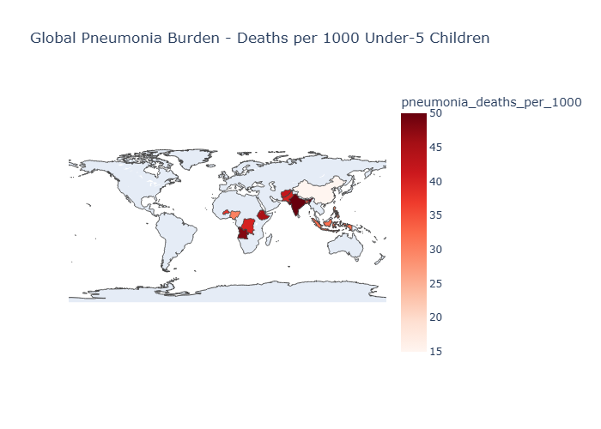

Slide 7
Indian Pneumonia Statistics
🇮🇳 Indian Context:
Annual episodes: 40-50 million cases
Mortality rate: 340,000 deaths annually
Case fatality: 2.3 per 1,000 persons
Child mortality: 17% of under-5 deaths
Highest burden: Uttar Pradesh, Bihar, Rajasthan

Slide 8
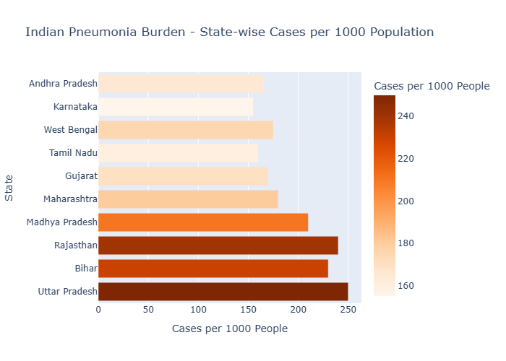

Slide 9
Etiological Agents
Microbial Spectrum in CAP:
1. Streptococcus pneumoniae - 25-40% (most common bacterial)
2. Mycoplasma pneumoniae - 15-30% (school-age peak)
3. Chlamydophila pneumoniae - 10-15% (young adults)
4. Haemophilus influenzae - 5-15% (COPD patients)
5. Legionella pneumophila - 2-10% (water systems)
6. Respiratory viruses - 15-20% (winter epidemics)
7. Staphylococcus aureus - 2-5% (post-viral)

Slide 10
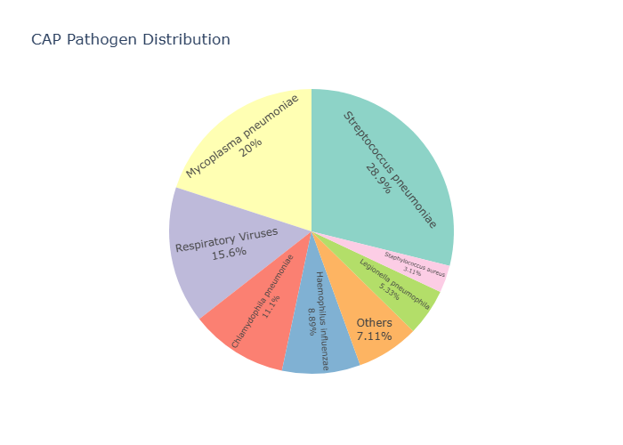

Slide 11
Risk Factors for Pneumonia
Host Factors:
Age extremes: <2 years and >65 years
Underlying diseases: COPD, diabetes, heart failure
Immunodeficiency: HIV, malignancy, immunosuppression
Lifestyle: Smoking, alcoholism, poor nutrition
Environmental Factors:
Air pollution: Indoor smoke, particulate matter
Crowding: Urban slums, dormitories
Malnutrition: Vitamin A, zinc deficiency
Seasonal: Winter epidemics, monsoon peaks

Slide 12
Pathophysiology of Pneumonia
Four-Step Sequence:
1. Colonization - Pathogen adheres to epithelium
2. Invasion - Bacterial multiplication in alveoli
3. Inflammation - Cytokine release, neutrophil migration
4. Consolidation - Exudate fills air spaces, impairs gas exchange

Slide 13
Host Defense Mechanisms
Anatomical Barriers:
Upper airways: Nasal filtration, mucociliary clearance
Cough reflex: Prevents aspiration
Bronchial tree: Hair cells, mucus production
Cellular Immunity:
Alveolar macrophages: Phagocytosis
Neutrophils: Acute inflammatory response
Complement system: Opsonization, chemotaxis
Humoral Immunity:
Antibodies: Serotype-specific protection
Immunoglobulins: IgG, IgM, IgA
Memory cells: Long-term immunity

Slide 14
Aspiration vs Inhalation Routes
Aspiration Pneumonia:
Most common route: Oropharyngeal contents
Risk factors: CNS disorders, dysphagia, unconsciousness
Anaerobic bacteria: Predominant in elderly
Chemical pneumonitis: Gastric acid injury
Inhalation Pneumonia:
Droplet nuclei: Mycobacteria, viruses, Legionella
Airborne transmission: RSV, influenza aerosols
Smaller inoculum: Survives upper airway defenses
Diffuse involvement: Often bilateral distribution

Slide 15
Typical vs Atypical Pneumonia
Feature | Typical Pneumonia | Atypical Pneumonia
Onset | Acute, sudden | Gradual, subacute
Fever | High, shaking chills | Low-grade
Cough | Productive, purulent | Dry, persistent
Chest pain | Pleuritic | Minimal
X-ray | Lobar consolidation | Interstitial pattern
White cells | Elevated neutrophils | Normal/mild elevation

Slide 16
Clinical Manifestations
Respiratory Symptoms:
Dyspnea: Progressive shortness of breath
Cough: Dry → productive with purulent sputum
Chest pain: Pleuritic, worse on inspiration
Hemoptysis: Rusty sputum (S. pneumoniae)
Systemic Symptoms:
Fever: High-grade with chills/rigors
Fatigue: Generalized weakness
Anorexia: Loss of appetite
Myalgias: Muscle aches and pains

Slide 17
Complications of Pneumonia
Respiratory Complications:
Pleural effusion/empyema
Lung abscess
Pneumothorax
ARDS
Systemic Complications:
Sepsis/septic shock
Acute kidney injury
Heart complications
Metabolic disorders

Slide 18
CBME Assessment Questions
Question 1: Most common cause of CAP?
A) Haemophilus influenzae
B) Streptococcus pneumoniae ⭐
C) Mycoplasma pneumoniae
D) Legionella pneumophila
Question 2: Pneumonia mortality in India?
A) 10,000 deaths/year
B) 50,000 deaths/year
C) 340,000 deaths/year ⭐
D) 1 million deaths/year

Slide 19
Learning Activities
📋 In-Class Activities:
1. Case Analysis: Review 3 pneumonia patient scenarios
2. Risk Factor Mapping: Group exercise on local determinants
3. Microbiology Quiz: Identify pathogens from descriptions
4. Epidemiology Exercise: Calculate local pneumonia burden
🏠 Homework Assignment:
Recall one pneumonia case from recent clinical posting
Identify risk factors present in that patient
Research local pneumonia statistics for tomorrow's discussion

Slide 20
Key Takeaways
🧠 Remember These Points:
1. Pneumonia = Acute lung infection with consolidation
2. 2.5 million deaths globally - mostly preventable
3. S. pneumoniae most common bacterial cause
4. Host + environmental factors determine risk
5. Typical vs atypical clinical presentations differ
6. Vaccination prevents most vaccine-preventable pneumonia

Slide 21
References & Further Reading
📚 Key References:
1. WHO Pneumonia Fact Sheet (2023)
2. Indian Academy of Pediatrics Guidelines (2022)
3. ATS/IDSA CAP Guidelines (2019)
4. Mandell LA, et al. Clinical Infectious Diseases (2019)
🔗 Useful Links:
WHO Pneumonia: https://www.who.int/health-topics/pneumonia
IAP Guidelines: https://iapindia.org/guidelines/
CDC Pneumonia: https://www.cdc.gov/pneumonia/

Slide 22
Session Evaluation
Please provide feedback:
What was most useful? __________
What needs improvement? __________
Additional topics to cover? __________
Overall rating: ⭐⭐⭐⭐⭐

Slide 23
Q&A Session
Email: hssling@yahoo.com
Phone: +91-8941087719
Next Session: Chapter 2 - Pneumonia Classification (CAP vs HAP)
Date: [Insert date] | Time: 9:00 AM - 10:30 AM
Venue: Integration Class Hall

